Slide 1
Library System Project
Group 9
Andualem
Ehab
Lisa
Binyam

Slide 2
Features:
LogIn
Add new Library member
Edit Member
Add book copy
Checkout Book
Additional features we may include
Print information of library members by their ID
Add Book

Slide 3
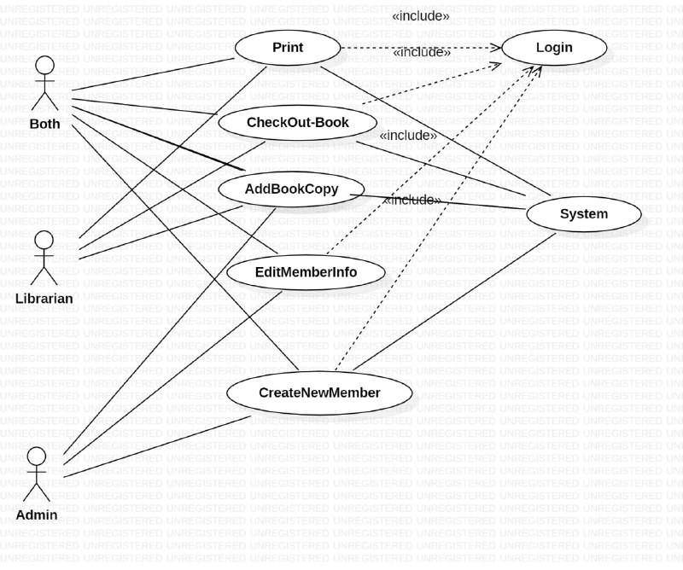
Usecase Diagram for library System

Slide 4
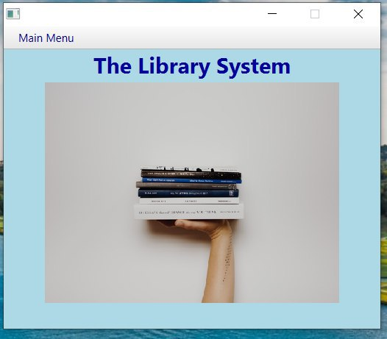
Main UI

Slide 5
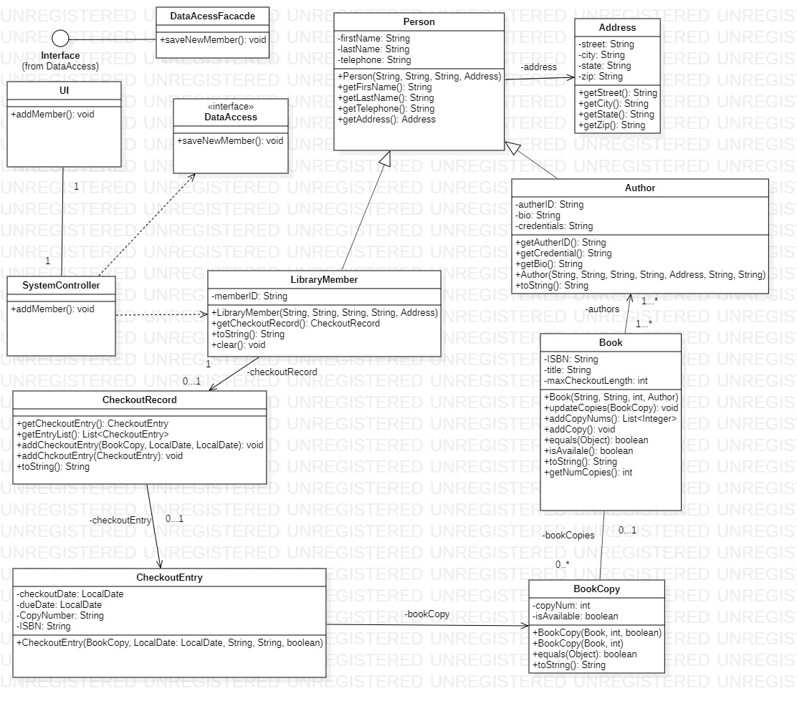
Class diagram:

Slide 6
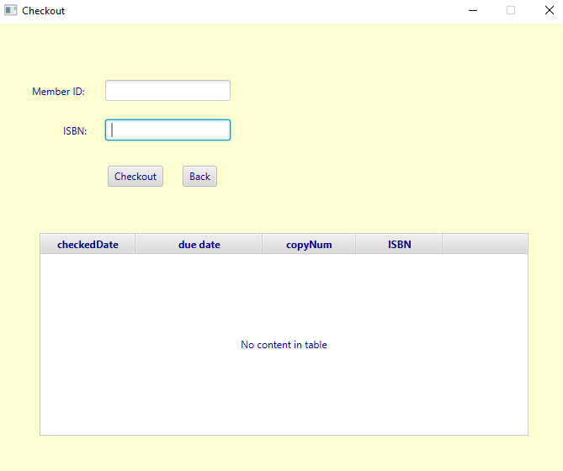
Checkout Book App screen

Slide 7
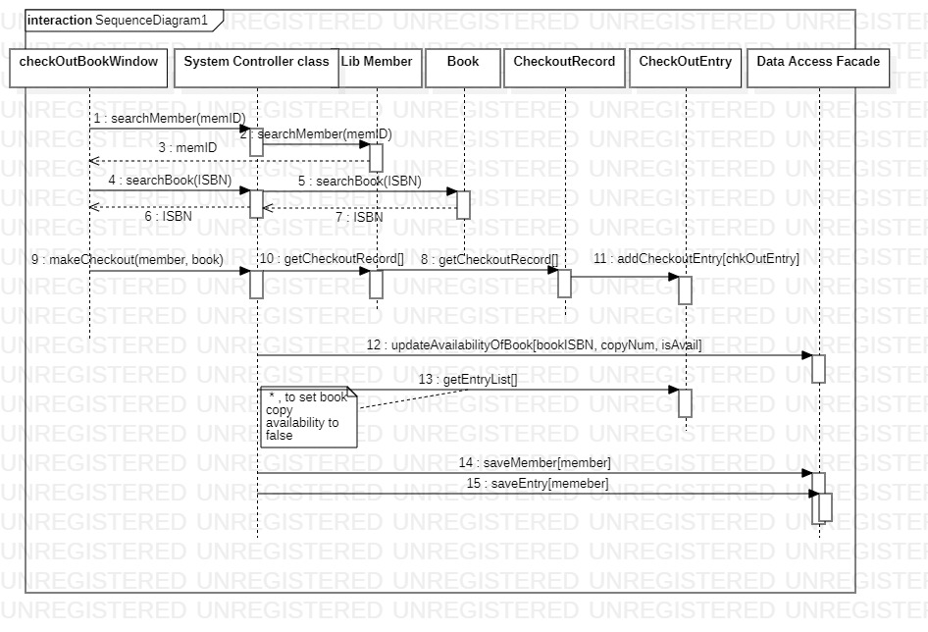
Sequence Diagram for “Checkout Book”

Slide 8
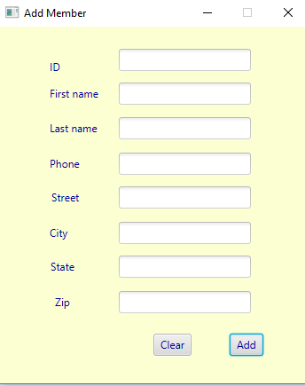
Add member UI

Slide 9
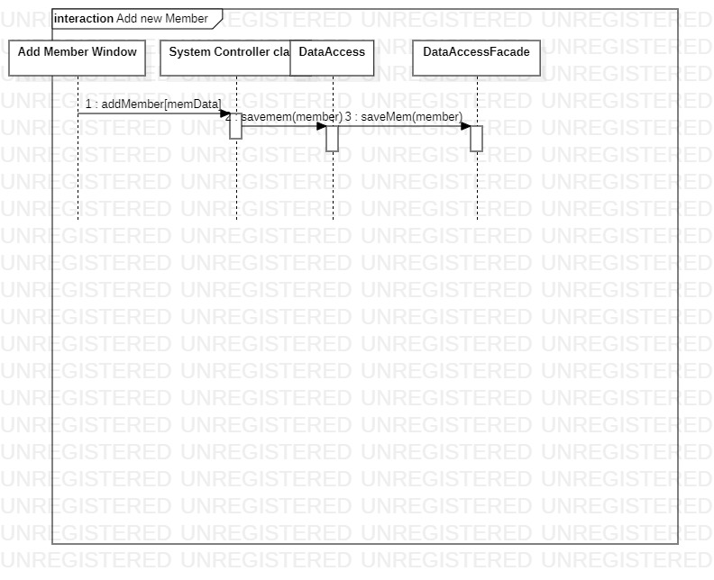
ADD member sequence diagram

Slide 10
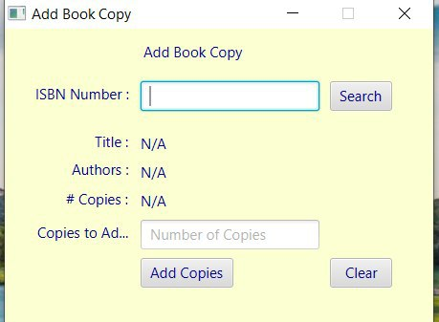
Add Copy of an Existing book screen

Slide 11
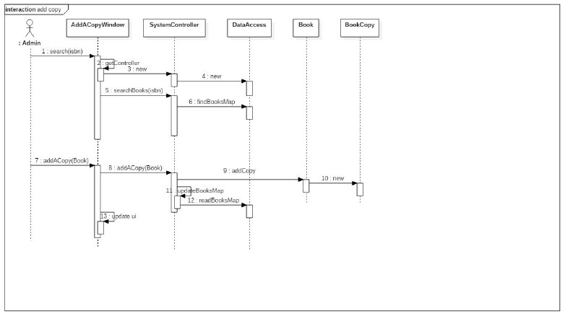
Add Copy of an Existing book

